Slide 1

CSCI/ARTI 8950 Machine Learning
Lecture Notes 11: Probabilistic Models
Khaled Rasheed
Professor
School of Computing
Member
Institute for Artificial Intelligence
University of Georgia
Credit: some examples & figures by Marine Carpuat, Tom Mitchell and Hal Daumé III

Slide 2
New topics
Bayes rule review
A probabilistic view of machine learning
Joint Distributions
Bayes optimal classifier
Statistical Estimation
Maximum likelihood estimates
Derive relative frequency as the solution to a constrained optimization problem

Slide 3
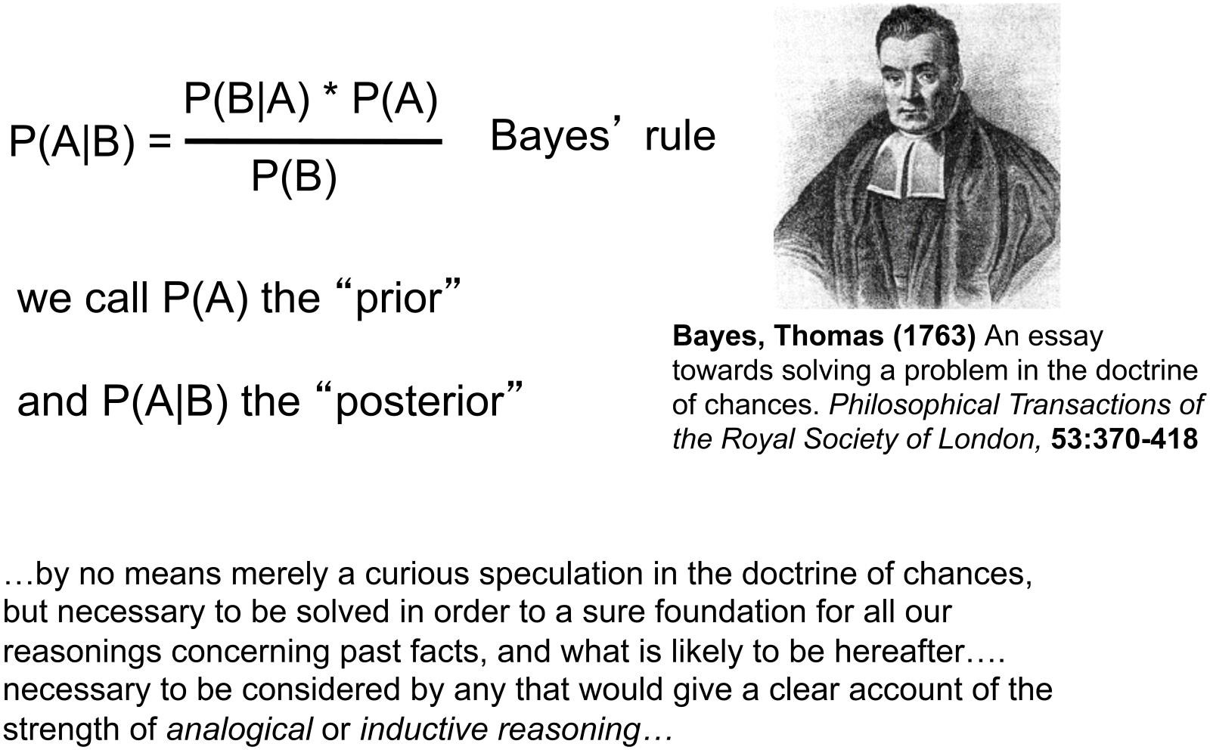
Bayes Rule

Slide 4
Exercise: Applying Bayes Rule
Consider the 2 random variables A = 1 if you have the flu, 0 otherwise B = 1 if you just coughed, 0 otherwise
Assume
P(A = 1) = 0.05
P(B = 1|A = 1) = 0.8 P(B = 1|A = 0) = 0.2
What is P(A = 1|B = 1)?

Slide 5
Answer
Using Bayes Rule
P(A|B)P(B) = P(B|A)P(A)
=> P(A|B) = P(B|A)P(A)/ P(B)
P(B) = 0.8*0.05 + 0.2*(1-0.05) = 0.04 + 0.19 = 0.23 P(A|B) = 0.8*0.05 / 0.23 = 4/23

Slide 6
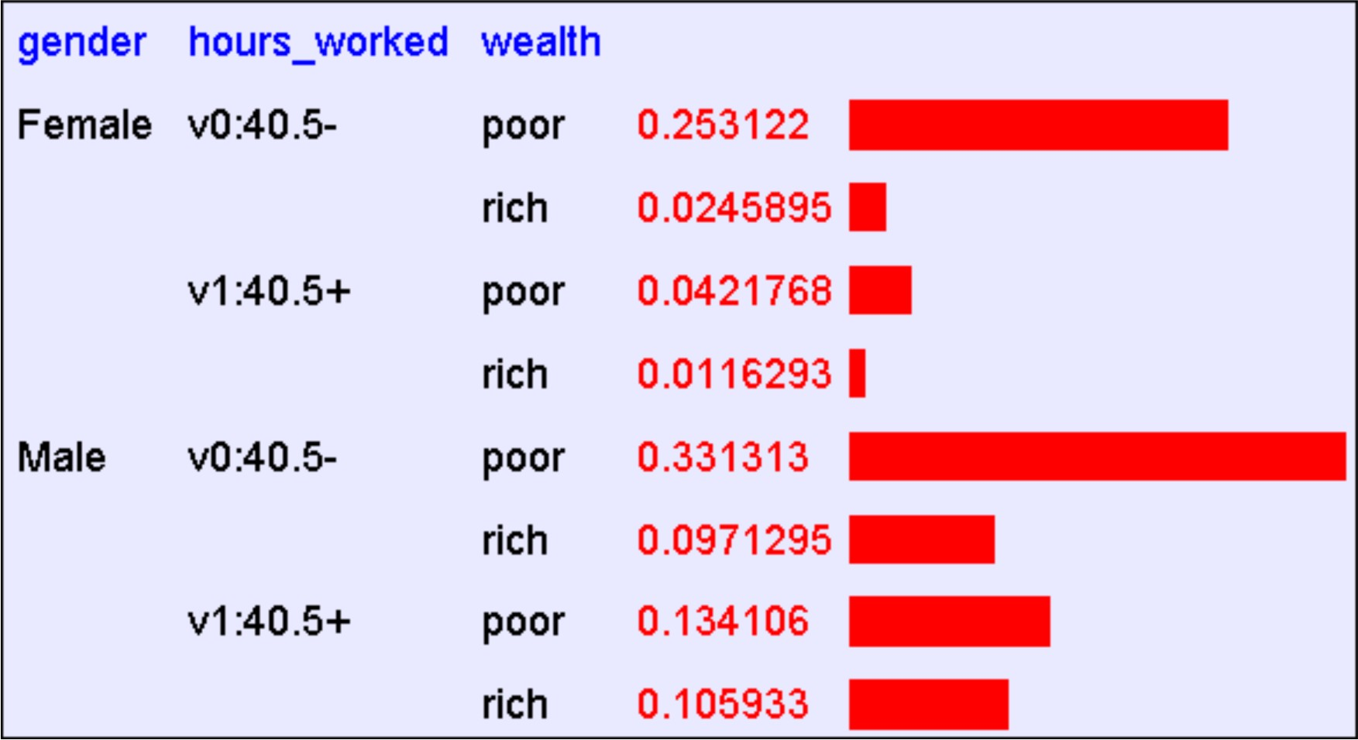
Using a Joint Distribution

Slide 7
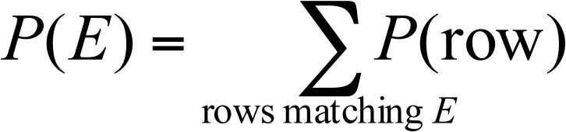
Using a Joint Distribution
Given the joint distribution, we can find the probability of any logical expression E involving these variables

Slide 8
Using a Joint Distribution
Given the joint distribution, we can make inferences
E.g., P(Male|Poor)?
Or P(Wealth | Gender, Hours)?

Slide 9
Recall: Machine Learning as Function Approximation
Problem setting
Set of possible instances 𝑋
Unknown target function 𝑓: 𝑋 → 𝑌
Set of function hypotheses 𝐻 = ℎ ℎ: 𝑋 → 𝑌}
Input
Training examples { 𝑥 ¹ , 𝑦 ¹
target function 𝑓
Output
, … 𝑥 ^{𝑁} , 𝑦 ^{𝑁} } of unknown
Hypothesis ℎ ∈ 𝐻 that best approximates target function 𝑓

Slide 10
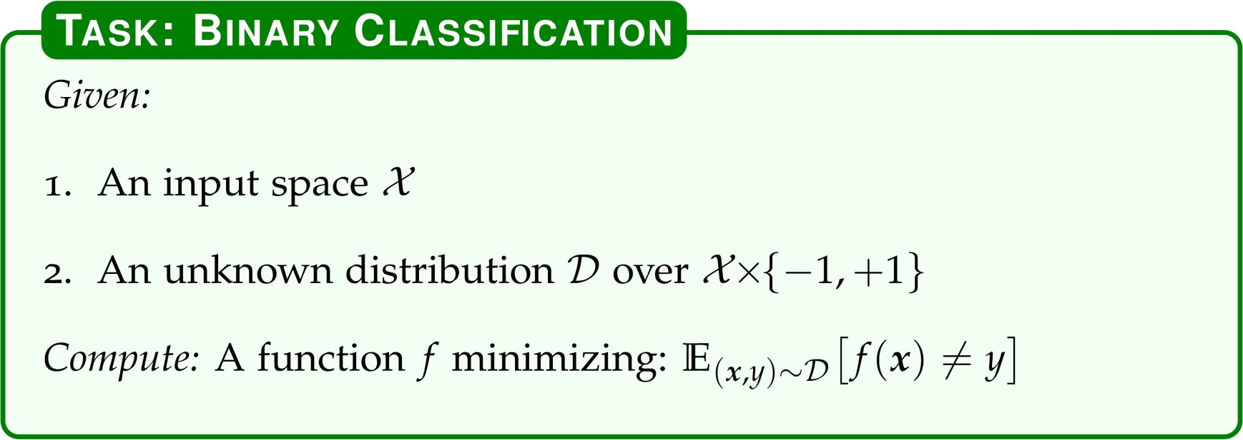
Recall: Formal Definition of Binary Classification (from CIML)

Slide 11
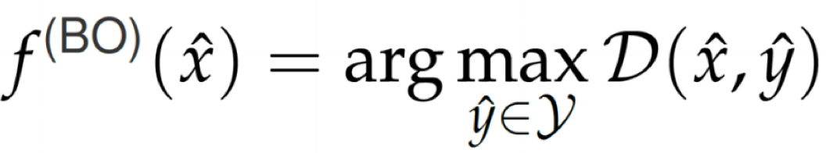
The Bayes Optimal Classifier
Assume we know the data generating distribution 𝒟
We define the Bayes Optimal Classifier as
Theorem: Of all possible classifiers, the Bayes Optimal Classifier achieves the smallest zero/one loss
Bayes error rate
Defined as the error rate of Bayes optimal classifier
Best error rate we can ever hope to achieve under zero/one loss
If we had access to 𝒟 we can build an optimal classifier
We don’t have access to 𝒟
We need to try to estimate it instead

Slide 12
What does “training” mean in probabilistic settings?
Training = estimating 𝒟 from a finite training set
– We typically assume that 𝒟 comes from a specific family of probability distributions
e.g., Bernouilli, Gaussian, etc
– Learning means inferring parameters of that distributions
e.g., mean and covariance of the Gaussian

Slide 13
Training assumption: training examples are iid
Independently and Identically distributed
i.e. as we draw a sequence of examples from
𝒟, the n-th draw is independent from the previous n-1 sample
This assumption is usually false!
But sufficiently close to true to be useful

Slide 14
How can we estimate the joint probability distribution from data?
What are the challenges?

Slide 15
Maximum Likelihood Estimation
Find the parameters that maximize the probability of the data

Slide 16
Example
How to model a biased coin?

Slide 17
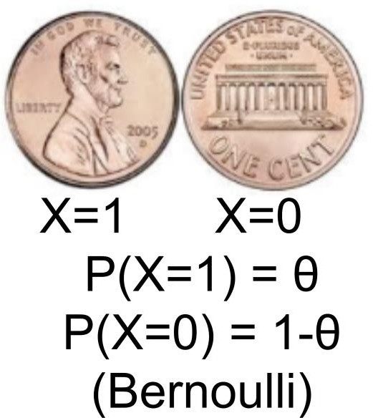
Maximum Likelihood Estimates
Each coin flip yields a Boolean value for X
X ~ Bernouilli: 𝑃 𝑋 = 𝜃^{𝑋}(1 − 𝜃)^{1-𝑋}
Given a data set D of iid flips, which contains 𝛼₁ ones and 𝛼₀ zeros
𝑃_{𝜃}(𝐷) = 𝜃^{𝛼1} (1 − 𝜃)^{𝛼0}
𝛼₁
_{𝜃}
= 𝑎𝑟𝑔𝑚𝑎𝑥_{𝜃} 𝑃_{𝜃} 𝐷 =
𝑀𝐿𝐸
𝛼₁ + 𝛼₀

Slide 18
Example
How to model a k-sided die?

Slide 19
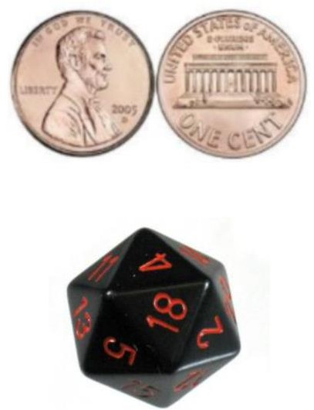
Maximum Likelihood Estimates
K-sided die: each die roll yields an integer between 1 and K
Given a data set D of iid rolls, where
side 𝑖
is observed 𝑥_{𝑖} times:
𝜃
𝑖
X ~ Discrete:

Slide 20
What we know so far…
Bayes rule
A probabilistic view of machine learning
If we know the data generating distribution, we can define the Bayes optimal classifier
Under iid assumption
How to estimate a probability distribution from data?
Maximum likelihood estimation

Slide 21
Let’s learn a classifier by learning P(Y|X)
Goal: learn a classifier P(Y|X)
Prediction:
– Given an example x
– Predict 𝑦 = 𝑎𝑟𝑔𝑚𝑎𝑥_{𝑦} 𝑃 𝑌 = 𝑦 𝑋 = 𝑥)

Slide 22
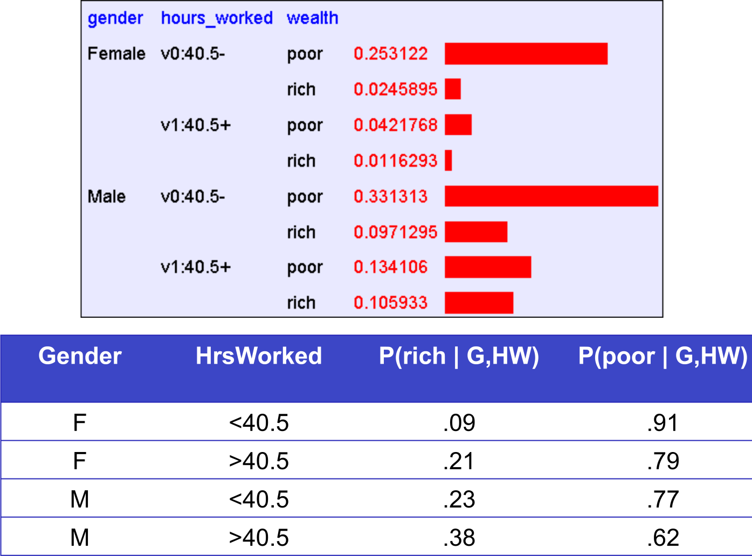
Parameters for P(X,Y) vs. P(Y|X)
Y = Wealth
X = <Gender, Hours_worked>
Joint probability
distribution P(X,Y)
Conditional probability distribution P(Y|X)

Slide 23
How many parameters do we need to estimate?
Suppose 𝑋 = < 𝑋₁, 𝑋₂, … 𝑋_{𝑑} >
where 𝑋_{𝑖} and 𝑌 are Boolean random variables
Q: How many parameters do we need to estimate
𝑃(𝑌|𝑋₁, 𝑋₂, … 𝑋_{𝑑})?

Slide 24
Naïve Bayes Assumption
Naïve Bayes assumes
𝑃 𝑋₁, 𝑋₂, … 𝑋_{𝑑} 𝑌
𝑃(𝑋_{𝑖} |𝑌)
i.e., that 𝑋_{𝑖} and 𝑋_{𝑗} are conditionally independent given Y, for all 𝑖 ≠ 𝑗

Slide 25
Conditional Independence
Definition:
X is conditionally independent of Y given Z if P(X|Y,Z) = P(X|Z)
Recall that X is independent of Y if P(X|Y)=P(X)

Slide 26
Naïve Bayes classifier
𝑦 = 𝑎𝑟𝑔𝑚𝑎𝑥_{𝑦} 𝑃 𝑌 = 𝑦 𝑋 = 𝑥)
= 𝑎𝑟𝑔𝑚𝑎𝑥_{𝑦}𝑃(𝑌 = 𝑦)𝑃 𝑋 = 𝑥 𝑌 = 𝑦)
= 𝑎𝑟𝑔𝑚𝑎𝑥_{𝑦}𝑃(𝑌 = 𝑦) 𝑃 𝑋_{𝑖} = 𝑥_{𝑖} 𝑌 = 𝑦)
Bayes rule
+ Conditional independence assumption

Slide 27
How many parameters do we need to estimate?
To describe P(Y)?
To describe 𝑃 𝑋 = < 𝑋₁, 𝑋₂, … 𝑋_{𝑑} > 𝑌)
Without conditional independence assumption?
With conditional independence assumption?
(Suppose all random variables are Boolean)

Slide 28
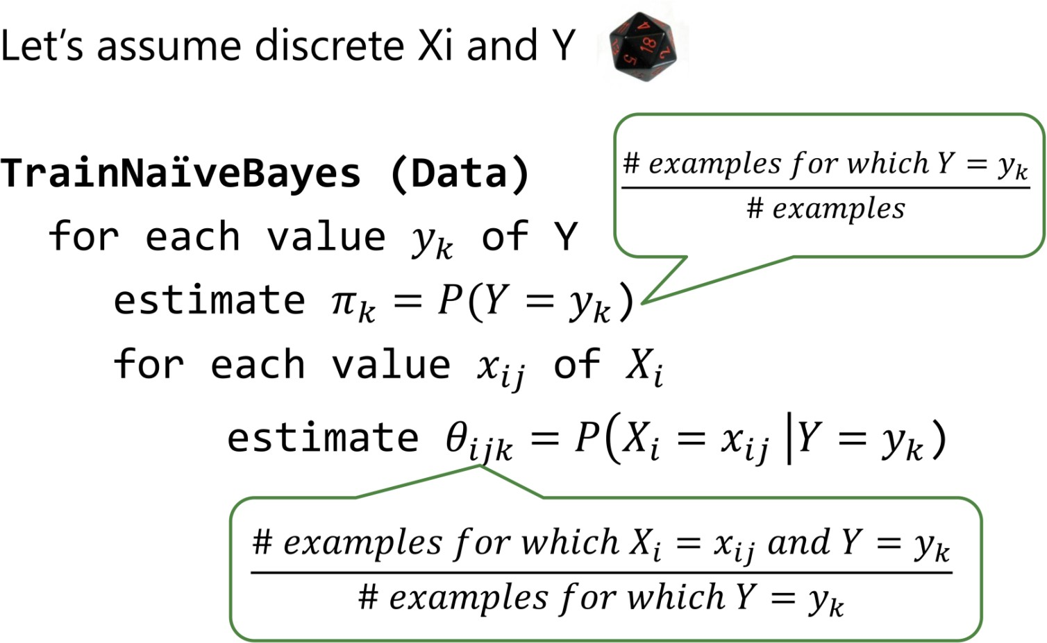
Training a Naïve Bayes classifier

Slide 29
Naïve Bayes: Example
Class:
C1:buys_computer = ‘yes’
Sample to be classified:
C2:buys_computer = ‘no’
X = (age <=30, Income = medium, Student = yes, Credit_rating = Fair)
age | income | student | credit_rating | buys_computer
<=30 | high | no | fair | no
<=30 | high | no | excellent | no
31…40 | high | no | fair | yes
>40 | medium | no | fair | yes
>40 | low | yes | fair | yes
>40 | low | yes | excellent | no
31…40 | low | yes | excellent | yes
<=30 | medium | no | fair | no
<=30 | low | yes | fair | yes
>40 | medium | yes | fair | yes
<=30 | medium | yes | excellent | yes
31…40 | medium | no | excellent | yes
31…40 | high | yes | fair | yes
>40 | medium | no | excellent | no

Slide 30
Naïve Bayes: Example
P(C_{i}):
P(buys_computer = “yes”) = 9/14 = 0.643 P(buys_computer = “no”) = 5/14= 0.357
Compute P(X|C_{i}) for each class
P(age = “<=30”|buys_computer = “yes”) = 2/9 = 0.222 P(age = “<= 30”|buys_computer = “no”) = 3/5 = 0.6
P(income = “medium” | buys_computer = “yes”) = 4/9 = 0.444
P(income = “medium” | buys_computer = “no”) = 2/5 = 0.4 P(student = “yes” | buys_computer = “yes) = 6/9 = 0.667 P(student = “yes” | buys_computer = “no”) = 1/5 = 0.2 P(credit_rating = “fair” | buys_computer = “yes”) = 6/9 = 0.667 P(credit_rating = “fair” | buys_computer = “no”) = 2/5 = 0.4
X = (age <= 30 , income = medium, student = yes, credit_rating = fair) P(X|C_{i}) : P(X|buys_computer = “yes”) = 0.222 x 0.444 x 0.667 x 0.667 = 0.044
P(X|buys_computer = “no”) = 0.6 x 0.4 x 0.2 x 0.4 = 0.019
P(X|C_{i})*P(C_{i}) : P(X|buys_computer = “yes”) * P(buys_computer = “yes”) = 0.028 P(X|buys_computer = “no”) * P(buys_computer = “no”) = 0.007
Therefore, X belongs to class (“buys_computer = yes”)

Slide 31
Naïve Bayes Wrap-up
An easy to implement classifier, that performs well in practice
Subtleties
Often the 𝑋_{𝑖} are not really conditionally independent
What if the Maximum Likelihood estimate for
𝑃 𝑋_{𝑖} = 𝑥_{𝑖} 𝑌 = 𝑦) is zero?

Slide 32
Avoiding Zero Probabilities
Naïve Bayesian prediction requires each conditional probability be non-zero
Otherwise, the predicted probability will be zero
Example. Suppose a dataset with 1000 tuples:
income = low (0), income= medium (990), and income = high (10)
Use Laplacian correction (or Laplacian estimator)
Adding 1 to each case
Prob(income = low) = 1/(1000 + 3) Prob(income = medium) = (990 + 1)/(1000 + 3) Prob(income = high) = (10 + 1)/(1000 + 3)
The “corrected” probability estimates are close to their “uncorrected” counterparts

Slide 33
What is the decision boundary of a Naïve Bayes classifier?

Slide 34
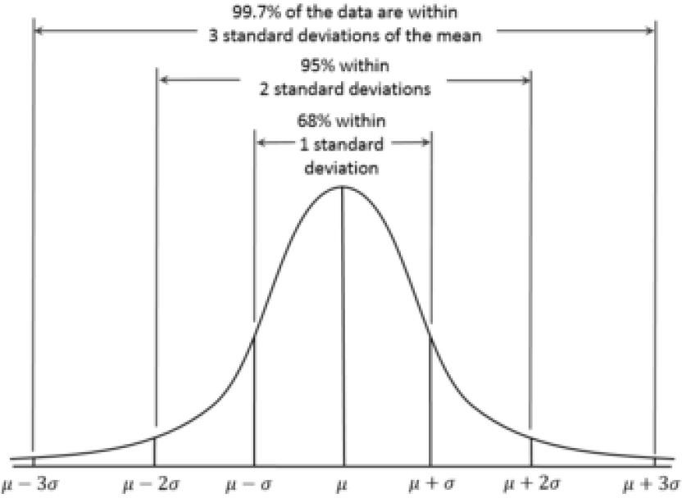
Naïve Bayes Properties
Naïve Bayes is a linear classifier
– See CIML for example of computation of Log Likelihood Ratio
Choice of probability distribution is a form of inductive bias

Slide 35
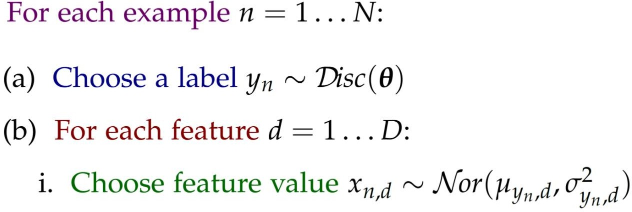
Generative Stories
Probabilistic models tell a fictional story explaining how our training data was created
Example of a generative story for a multiclass classification task with continuous features

Slide 36
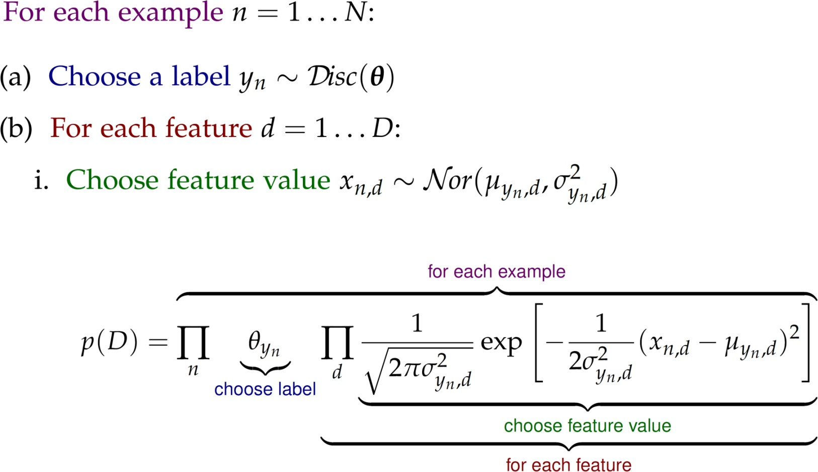
From the Generative Story to the Likelihood Function

Slide 37
Probabilistic Graphical Models
Many of the following slides are derived from Tom Mitchell, Ziv Joseph, and S. Kim.

Slide 38


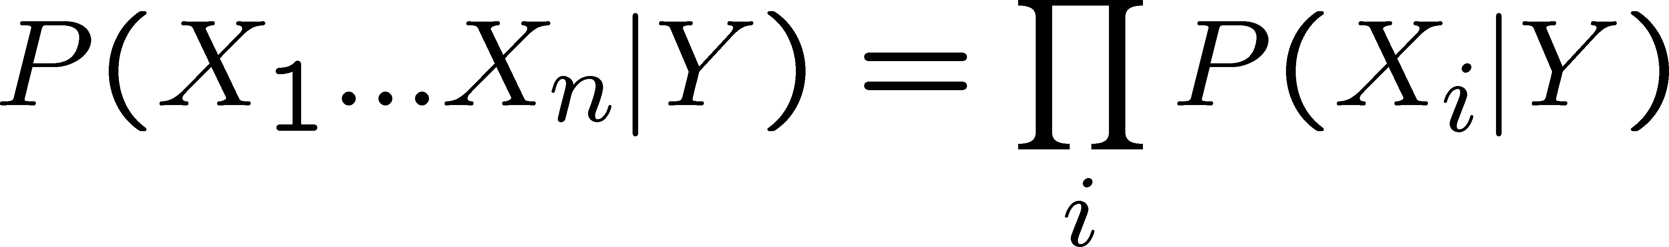
Naïve Bayes Classiﬁer Revisited
Full joint distribution: exponential number of parameters
Conditional independence assumption for Naïve Bayes classiﬁer: linear number of parameters
P(X|Y) = P(X₁,… X_{n} |Y)
Probabilistic graphical models

Slide 39
Probabilistic Graphical Models
Key Idea:
Conditional independence assumptions useful
but Naïve Bayes is extreme!
Probabilistic graphical models are a joint probability distribution deﬁned over a graph
sets of conditional independence assumptions are expressed via graph structure
Two types of graphical models:
Directed graphs (aka Bayesian Networks)
Undirected graphs (aka Markov Random Fields)

Slide 40


Slide 41
Marginal Independence
Deﬁnition: X is marginally independent of Y if
Equivalently, if
Equivalently, if

Slide 42
Conditional Independence
Deﬁnition: X is conditionally independent of Y given Z, if the probability distribution governing X is independent of the value of Y, given the value of Z
which we often write
E.g.,

Slide 43
Directed Acyclic Graph
A directed acyclic graph is deﬁned by:
A set of nodes
A set of edges, such that directed edges do not form a cycle
B
E
A
Terminology
Parents of node v
Children of node v
Descendents of node v
J
M

Slide 44
Bayesian Networks Deﬁnition
A Bayes network represents the joint probability distribution over a collection of random variables
A Bayes network is a directed acyclic graph and a set of conditional probability distributions (CPD’s)
Each node denotes a random variable
Edges denote dependencies

Slide 45
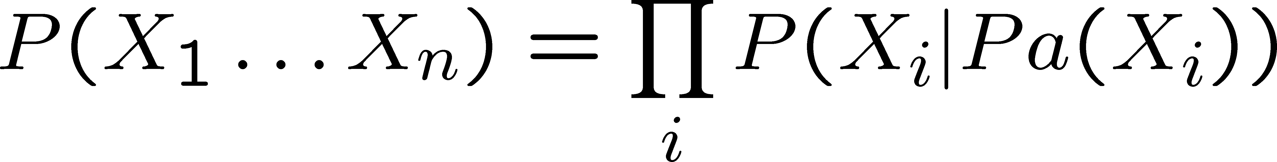
Bayesian Networks Deﬁnition
A Bayes network represents the joint probability distribution over a collection of random variables
A Bayes network is a directed acyclic graph and a set of conditional probability distributions (CPD’s)
Each node denotes a random variable
Edges denote dependencies
For each node X_{i} its CPD deﬁnes P(X_{i} | Pa(X_{i}))
The joint distribution over all variables is deﬁned to be
Pa(X) = immediate parents of X in the graph

Slide 46
Bayesian networks
Let’s use a movie example: We would like to determine the joint probability for length, liked and slept in a movie
Lo
Long?
Li
Slept
Slept?
Liked?

Slide 47
Bayesian networks: Notations
Bayesian networks are directed acyclic graphs.
Conditional probability tables (CPTs)
P(Lo) = 0.5
Conditional dependency
Lo
P(Li | Lo) = 0.4
P(Li | ¬Lo) = 0.7
P(S | Lo) = 0.6 P(S | ¬Lo) = 0.2
Li
S
Random variables

Slide 48





Bayesian networks: Notations
The Bayesian network below represents the following joint probability distribution:
p(Lo,Li,S) = P(Lo)P(Li | Lo)P(S | Lo)
More generally Bayesian network represent the following joint probability distribution:
P(Lo) = 0.5
The set of parents of x_{i} in the graph
Lo
P(Li | Lo) = 0.4
P(Li | ¬Lo) = 0.7
P(S | Lo) = 0.6 P(S | ¬Lo) = 0.2
Li
S

Slide 49
Constructing a Bayesian network
How do we go about constructing a network for a speciﬁc problem?
Step 1: Identify the random variables
Step 2: Determine the conditional dependencies Step 3: Populate the CPTs
Can be learned from observation data!

Slide 50
A example problem
An alarm system
B – Did a burglary occur?
E – Did an earthquake occur? A – Did the alarm go oﬀ?
M – Mary calls
J – John calls
How do we reconstruct the network for this problem?

Slide 51
Factoring joint distributions
Using the chain rule we can always factor a joint distribution as follows:
P(M,J,A,B,E) =
P(M |J,A,B,E) P(J,A,B,E) =
P(M | J,A,B,E) P(J | A,B,E) P(A| B,E) =
P(M | J,A,B,E) P(J | A,B,E) P(A | B,E) P(B,E)
P(M | J,A,B,E) P(J | A,B,E) P(A | B,E)P(B | E)P(E)
This type of conditional dependencies can also be represented graphically.

Slide 52
A Bayesian network
P(M | J,A,B,E) P(J | A,B,E) P(A | B,E)P(B | E)P(E)
A
B
Number of parameters: M: 2^4
J: 2^3 A: 4
B: 2
E: 1
E
A total of 31 parameters
J
M

Slide 53
A better approach
An alarm system
B – Did a burglary occur?
E – Did an earthquake occur? A – Did the alarm go oﬀ?
M – Mary calls
J – John calls
Let’s use our knowledge of the domain!

Slide 54
Reconstructing a network
B – Did a burglary occur?
E – Did an earthquake occur? A – Did the alarm go oﬀ?
M – Mary calls J – John calls
B
E
A
J
M
P(B)P(E)P(A|B,E)P(J|A)P(M|A)

Slide 55
Reconstructing a network
P(B)P(E)P(A|B,E)P(J|A)P(M|A)
Number of parameters: A: 4
B: 1
E: 1
J: 2
M: 2
B E
A
J
M
A total of 10 parameters
By relying on domain knowledge we saved 21 parameters!

Slide 56


A Bayesian network
P(M | J,A,B,E) P(J | A,B,E) P(A | B,E)P(B | E)P(E)
P(M|A) P(J|A) P(A|B,E) P(B) P(E)
A
B
B
E
E
A
J
M
J
M

Slide 57
Constructing a Bayesian network: Revisited
Step 1: Identify the random variables
Step 2: Determine the conditional dependencies
-­‐ Select an ordering of the variables
-­‐ Add them one at a time
-­‐ For each new variable X added, select the minimal subset of nodes as parents such that X is independent from all other nodes in the current network given its parents.
Step 3: Populate the CPTs
-­‐ From examples using density estimation

Slide 58
Bayesian network: Inference
Once the network is constructed, we can use algorithms for inferring the values of unobserved variables.
For example, in our previous network the only observed variables are the phone calls. However, what we are really interested in is whether there was a burglary or not.
How can we determine that?

Slide 59
Inference
Let’s start with a simpler question
-­‐ How can we compute a joint distribution from the network?
-­‐ For example, P(B,¬E,A,J, ¬M)?
Answer:
-­‐ That’s easy, let’s use the network

Slide 60
Computing: P(B,¬E,A,J, ¬M)
P(B,¬E,A,J, ¬M) =
P(B)P(¬E)P(A | B, ¬E) P(J | A)P(¬M | A)
= 0.05*0.9*.85*.7*.2
P(B)=.05
P(E)=.1
B
E
= 0.005355
P(A|B,E) =.95
P(A|B,¬E) = .85
P(A| ¬ B,E) =.5
P(A| ¬ B, ¬ E) = .05
A
P(J|A) )=.7
P(J|¬A) = .05
J
M
P(M|A) =.8
P(M|¬A) = .15

Slide 61
Computing: P(B,¬E,A,J, ¬M)
P(B,¬E,A,J, ¬M) =
P(B)P(¬E)P(A | B, ¬E) P(J | A)P(¬M | A)
= 0.05*0.9*.85*.7*.2
P(B)=.05
P(E)=.1
B
E
= 0.005355
We can easily compute a complete joint distribution. What about partial distributions? Conditional distributions?
P(A|B,E) )=.95
P(A|B,←E) = .85
P(A| ← B,E) )=.5
P(A| ← B, ← E) = .05
A
P(J|A) )=.7
P(J|¬A) = .05
J
M
P(M|A) )=.8
P(M|¬A) = .15

Slide 62












Inference
We are interested in queries of the form: P(B | J,¬M)
This can also be written as:
B
E
A
How do we compute the new joint?
J
M

Slide 63
Inference in Bayesian networks
Three major approaches:
Enumeration (Covered in this lecture)
Variable elimination
Stochastic inference

Slide 64
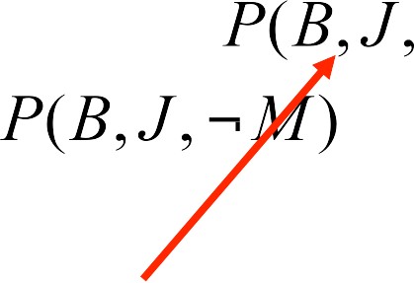




Computing partial joints
Sum all instances with these settings (the sum is over the possible assignments to the other two variables, E and A)

Slide 65
Computing: P(B,J, ¬M)
P(B,J, ¬M) = P(B,J, ¬M,A,E) +
P(B,J, ¬M, ¬ A,E) +
P(B,J, ¬M,A, ¬ E) +
P(B,J, ¬M, ¬ A, ¬ E)
= 0.0007+0.00001+0.005+0.0003
= 0.00601
P(B)=.05
P(E)=.1
B
E
P(A|B,E) )=.95
P(A|B,¬E) = .85
P(A| ¬ B,E) )=.5
P(A| ¬ B, ¬ E) = .05
A
P(J|A) )=.7
P(J|¬A) = .05
J
M
P(M|A) )=.8
P(M|¬A) = .15

Slide 66






Computing partial joints
Sum all instances with these settings (the sum is over the possible assignments to the other two variables, E and A)
This method can be improved by re-­‐using calculations (similar to dynamic programming)
Still, the number of possible assignments is exponential in the number of unobserved variables?
That is, unfortunately, the best we can do. General querying of Bayesian networks is NP-­‐complete

Slide 67
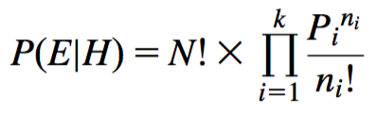
Multinomial naïve Bayes I
Version of naïve Bayes used for document classification using bag of words model
n₁,n₂, ... , n_{k}: number of times word i occurs in the document
P₁,P₂, ... , P_{k}: probability of obtaining word i when sampling from documents in class H
Probability of observing a particular document E given probabilities class H (based on multinomial distribution):
Note that this expression ignores the probability of generating a document of the right length
This probability is assumed to be constant for all classes
[Source: Data Mining by Witten, Frank, Hall and Pal]

Slide 68
Multinomial naïve Bayes II
Suppose dictionary has two words, yellow and blue
Suppose P(yellow | H) = 75% and P(blue | H) = 25%
Suppose E is the document “blue yellow blue”
Probability of observing document: Suppose there is another class H' that has P(yellow | H’) = 10% and P(blue| H’) = 90%:
Need to take prior probability of class into account to make the final classification using Bayes’ rule
Factorials do not actually need to be computed: they drop out
Underflows can be prevented by using logarithms
[Source: Data Mining by Witten, Frank, Hall and Pal]

Slide 69
What you should know
The Naïve Bayes classifier
Conditional independence assumption
How to train it?
How to make predictions?
How does it relate to other classifiers we know?
The Bayesian Networks
Fundamental Machine Learning concepts
iid assumption
Bayes optimal classifier
Maximum Likelihood estimation

